Slide 1

Different Statistical Performance Metric for Regression

Slide 2

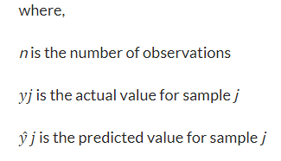
Evaluation metrics for Regression
1. Mean Absolute Error (MAE)
Mean Absolute Error is the average of the difference between the original value and the predicted value. It gives you the measure of how far the predictions are from the actual output and obviously, you would want to minimize it. However, it doesn’t give you an idea of the direction of the error since you are taking only the absolute values. It is most Robust to outliers.
Demerits: The graph of MAE is not differentiable so we have to apply various optimizers like Gradient descent which can be differentiable.

Slide 3

Evaluation metrics for Regression
2. Mean squared error (MSE)
This is the mean of the squared difference of the actual value in the dataset and the value predicted by the model. Mean Squared Error (MSE) is similar to MAE, the only difference being that MSE takes the average of the square of the difference between the original values and the predicted values which eases the process of gradient calculation, penalizes the error terms more, and is unbiased towards the direction of error (since you are squaring). However, this makes it more sensitive to outliers. The graph of MSE is differentiable, so you can easily use it as a loss function.
Demerits: The value you get after calculating MSE is a squared unit of output.

Slide 4

Evaluation metrics for Regression
3. Root mean squared error (RMSE)
It is the mean of root squared subtraction between the actual value in the dataset and the value predicted by the model. It’s the same as MSE, we are just taking the root of it. The smaller the value of root mean squared error, the more accurate the model is. The output value you get is in the same unit as the required output variable which makes interpretation of loss easy.
Demerits: It is not that robust to outliers as compared to MAE.

Slide 5

Evaluation metrics for Regression
4. Sum of Squares Total (SST)
The sum of squared differences between individual data points and the mean of the response variable.

Slide 6

Evaluation metrics for Regression
5. Sum of Squares Regression (SSR)
The sum of squared differences between predicted data points (ŷi) and the mean of the response variable(y).

Slide 7


Evaluation metrics for Regression
6. Sum of Squares Error (SSE)
The sum of squared differences between predicted data points (ŷi) and observed data points (yi).
Relationship between SSR and SSE with SST is

Slide 8


Evaluation metrics for Regression
7. R Square / Coefficient of Determination/ Goodness of fit
It estimates the ratio of the variance of the dependent element described by the target element. It’s used for finding the accuracy of the model. It depicts the closeness of the data points to the trend line made by the model. This helps to make a link between the independent element and the target element. R square is from zero to one. The nearer R square is to one, the more accurate the model.

Slide 9
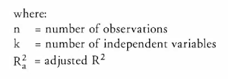

Evaluation metrics for Regression
8. Adjusted R Squared
The disadvantage of the R2 score is while adding new features in data the R2 score starts increasing or remains constant but it never decreases because It assumes that while adding more data variance of data increases. But the problem is when we add an irrelevant feature in the dataset then at that time R2 sometimes starts increasing which is incorrect. Hence, To control this situation Adjusted R Squared came into existence.

Slide 10
Evaluation metrics for Regression
9. Adjusted R Squared
The disadvantage of the R2 score is while adding new features in data the R2 score starts increasing or remains constant but it never decreases because It assumes that while adding more data variance of data increases. But the problem is when we add an irrelevant feature in the dataset then at that time R2 sometimes starts increasing which is incorrect. Hence, To control this situation Adjusted R Squared came into existence.

Slide 11
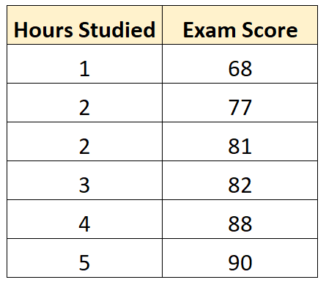
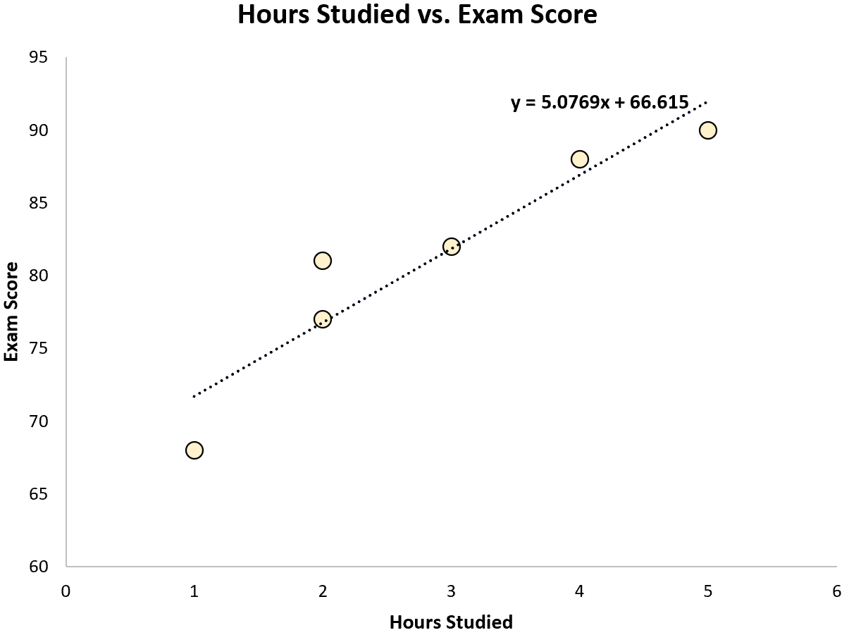
Example 1: Suppose we have the following dataset that shows the number of hours studied by six different students along with their final exam scores:
We can find that the line of best fit is:
Score = 66.615 + 5.0769*(Hours)
Once we know the line of best fit equation, we can use the following steps to calculate SST, SSR, and SSE:

Slide 12
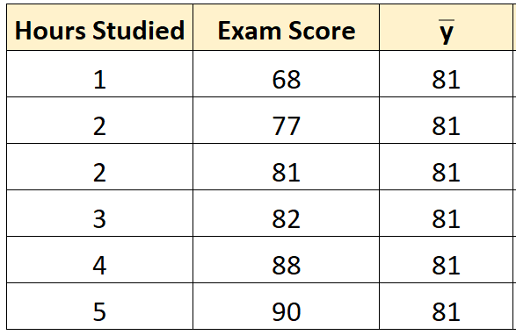
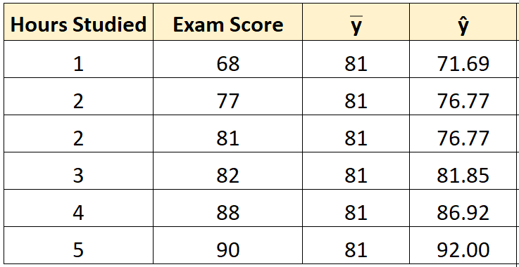
Step 1: Calculate the mean of the response variable.
The mean of the response variable turns out to be 81.
Step 2: Calculate the predicted value for each observation.
Next, we can use the line of best fit equation to calculate the predicted exam score () for each student.
For example, the predicted exam score for the student who studied one hours is:
Score = 66.615 + 5.0769*(1) = 71.69.
We can use the same approach to find the predicted score for each student:

Slide 13
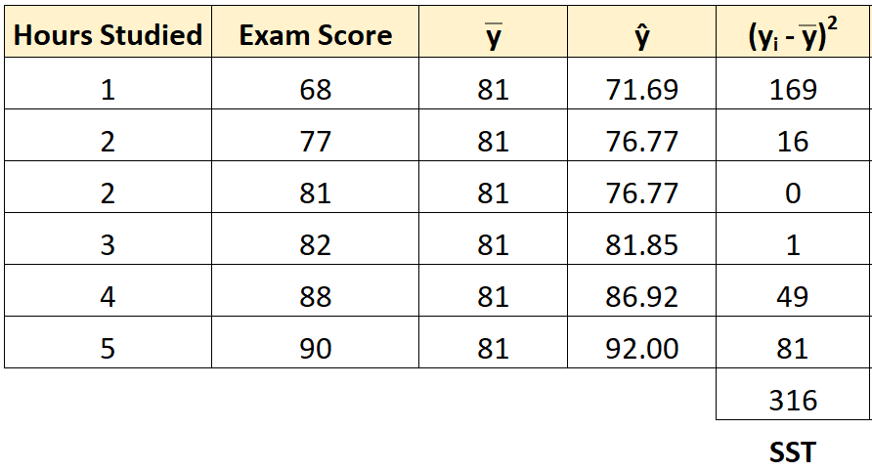

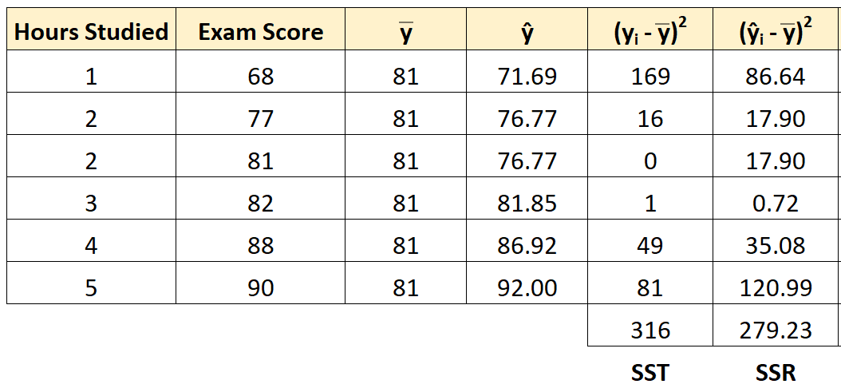

Step 3: Calculate the sum of squares total (SST).
Next, we can calculate the sum of squares total.
For example, the sum of squares total for the first student is:
We can use the same approach to find the sum of squares total for each student:
The sum of squares total turns out to be 316.
Step 4: Calculate the sum of squares regression (SSR).
Next, we can calculate the sum of squares regression.
For example, the sum of squares regression for the first student is:
We can use the same approach to find the sum of squares regression for each student:

Slide 14

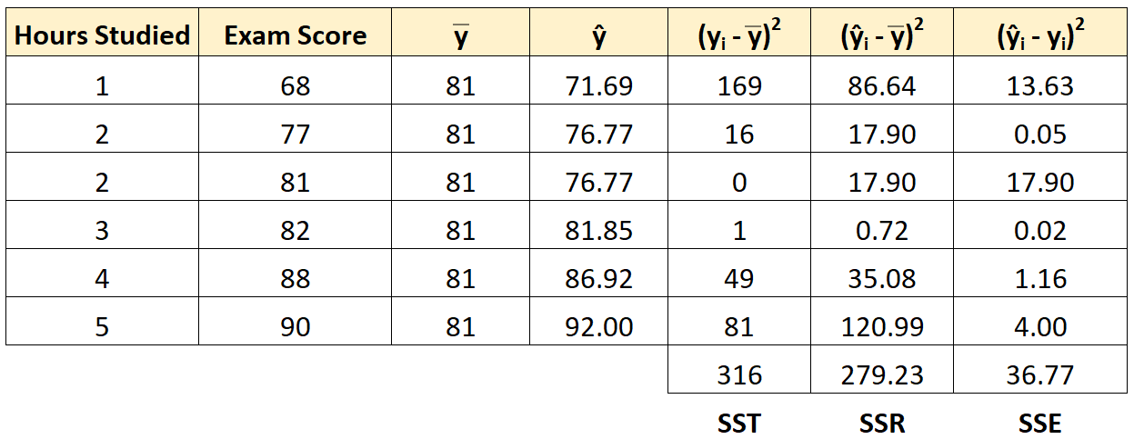
The sum of squares regression turns out to be 279.23.
Step 5: Calculate the sum of squares error (SSE).
Next, we can calculate the sum of squares error. For example, the sum of squares error for the first student is:
We can use the same approach to find the sum of squares error for each student:
We can verify that SST = SSR + SSE
SST = SSR + SSE
316 = 279.23 + 36.77
We can also calculate the R-squared of the regression model by using the following equation:
R-squared =1- SSR / SST
R-squared = 279.23 / 316
R-squared = 0.8836
This tells us that 88.36% of the variation in exam scores can be explained by the number of hours studied.

Slide 15

Thank you

